Slide 1
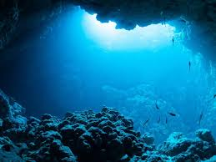
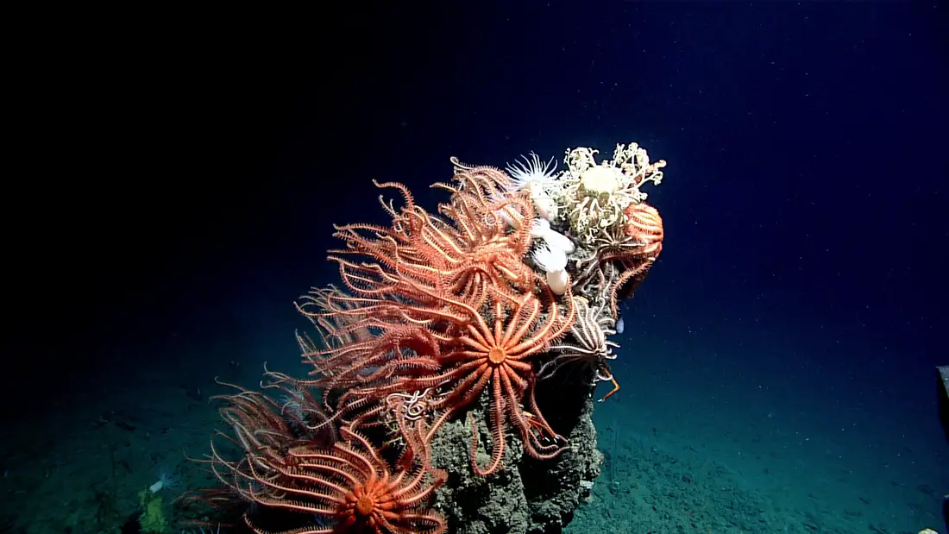
Deep Sea Image Classification
Cloud Computing
Jennifer Crosby
Benjamin Lee
Polly McKim

Slide 2

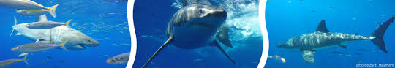
Overall Project
Acquired deep sea research expedition images from NOAA
Built and deployed a machine learning model to classify images as interesting or not interesting based on creature presence
Used AWS architecture to greatly increase speed and scalability of the model
Delivered a model of close to 70% accuracy
Used a CNN (convolutional neural network) algorithm as our model

Slide 3


Sources Used
NOAA repository of deep sea images
CVision AI (http://cvisionai.com/) houses NOAA images on an online server
1500 images + additional created through image augmentation

Slide 4


Features Implemented
Python libraries to install:
Pandas, numpy , matplotlib, sklearn, pytorch, pytorchvision,
warnings, PIL, image_folder, random
To use in model:
CNN, Adam optimizer, back propagation
JKC

Slide 5
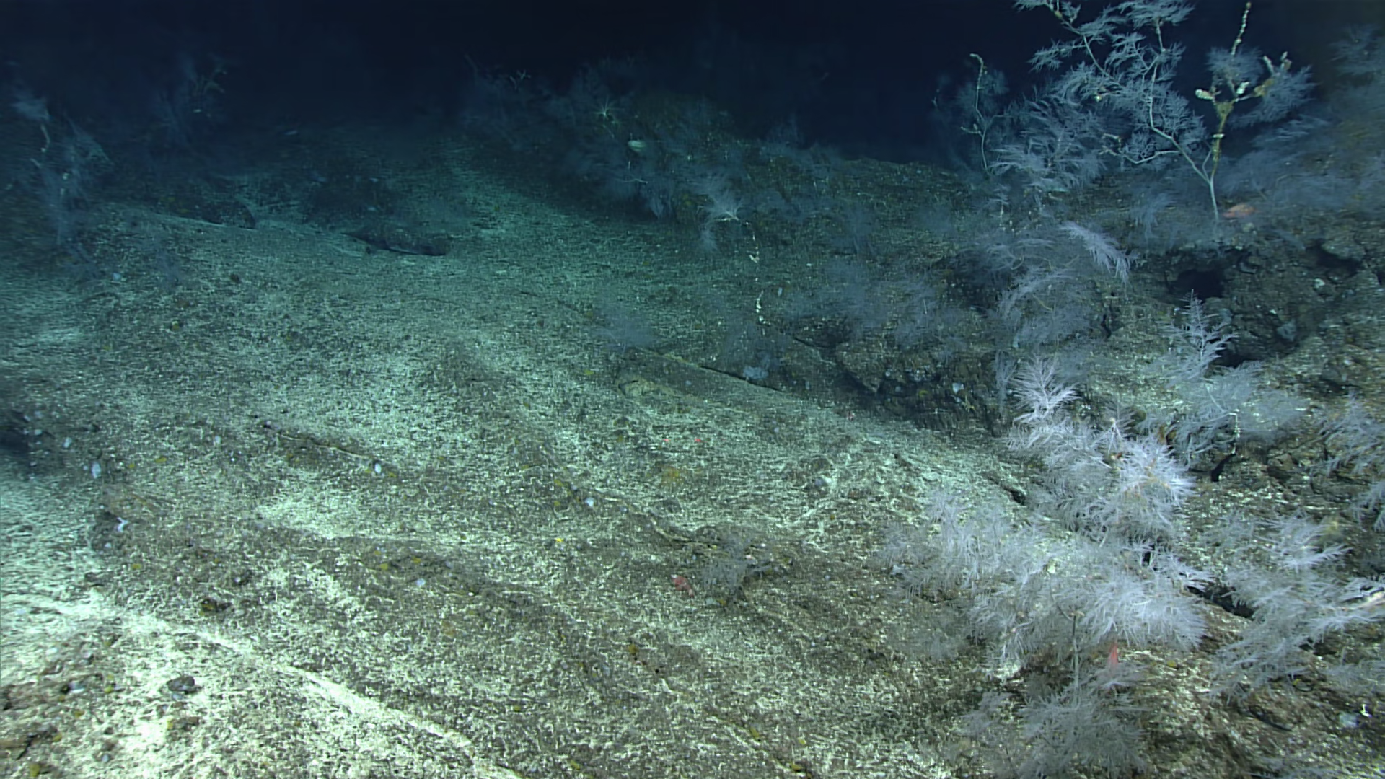
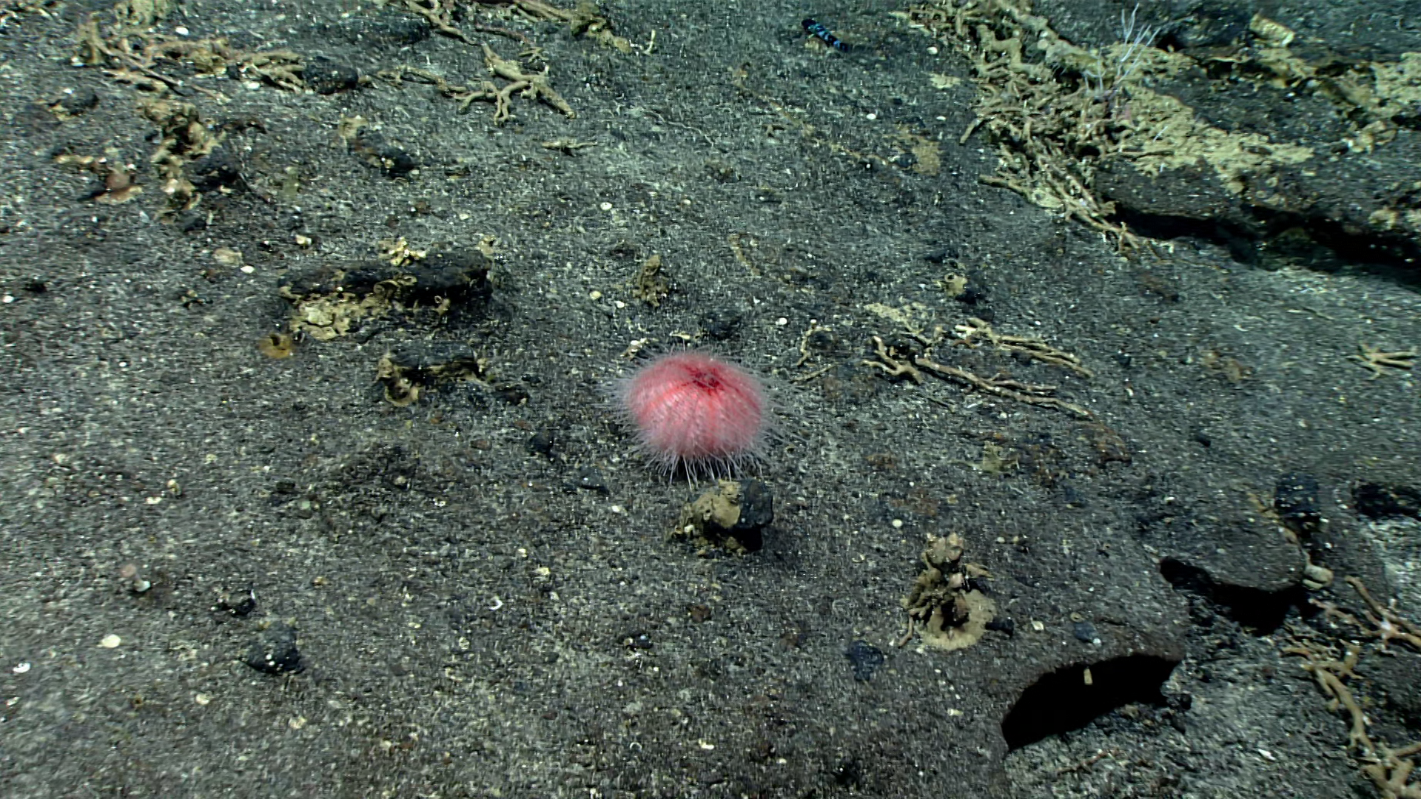
Examples of Inputs
Not Interesting
Interesting

Slide 6


AWS Architecture Used for Project
EC2 (AMI Name Deep Learning Base AMI (Ubuntu 18.04) Version 31.0); Type: g3.4xlarge
VPC
AWS Cloud9- Cloud IDE

Slide 7
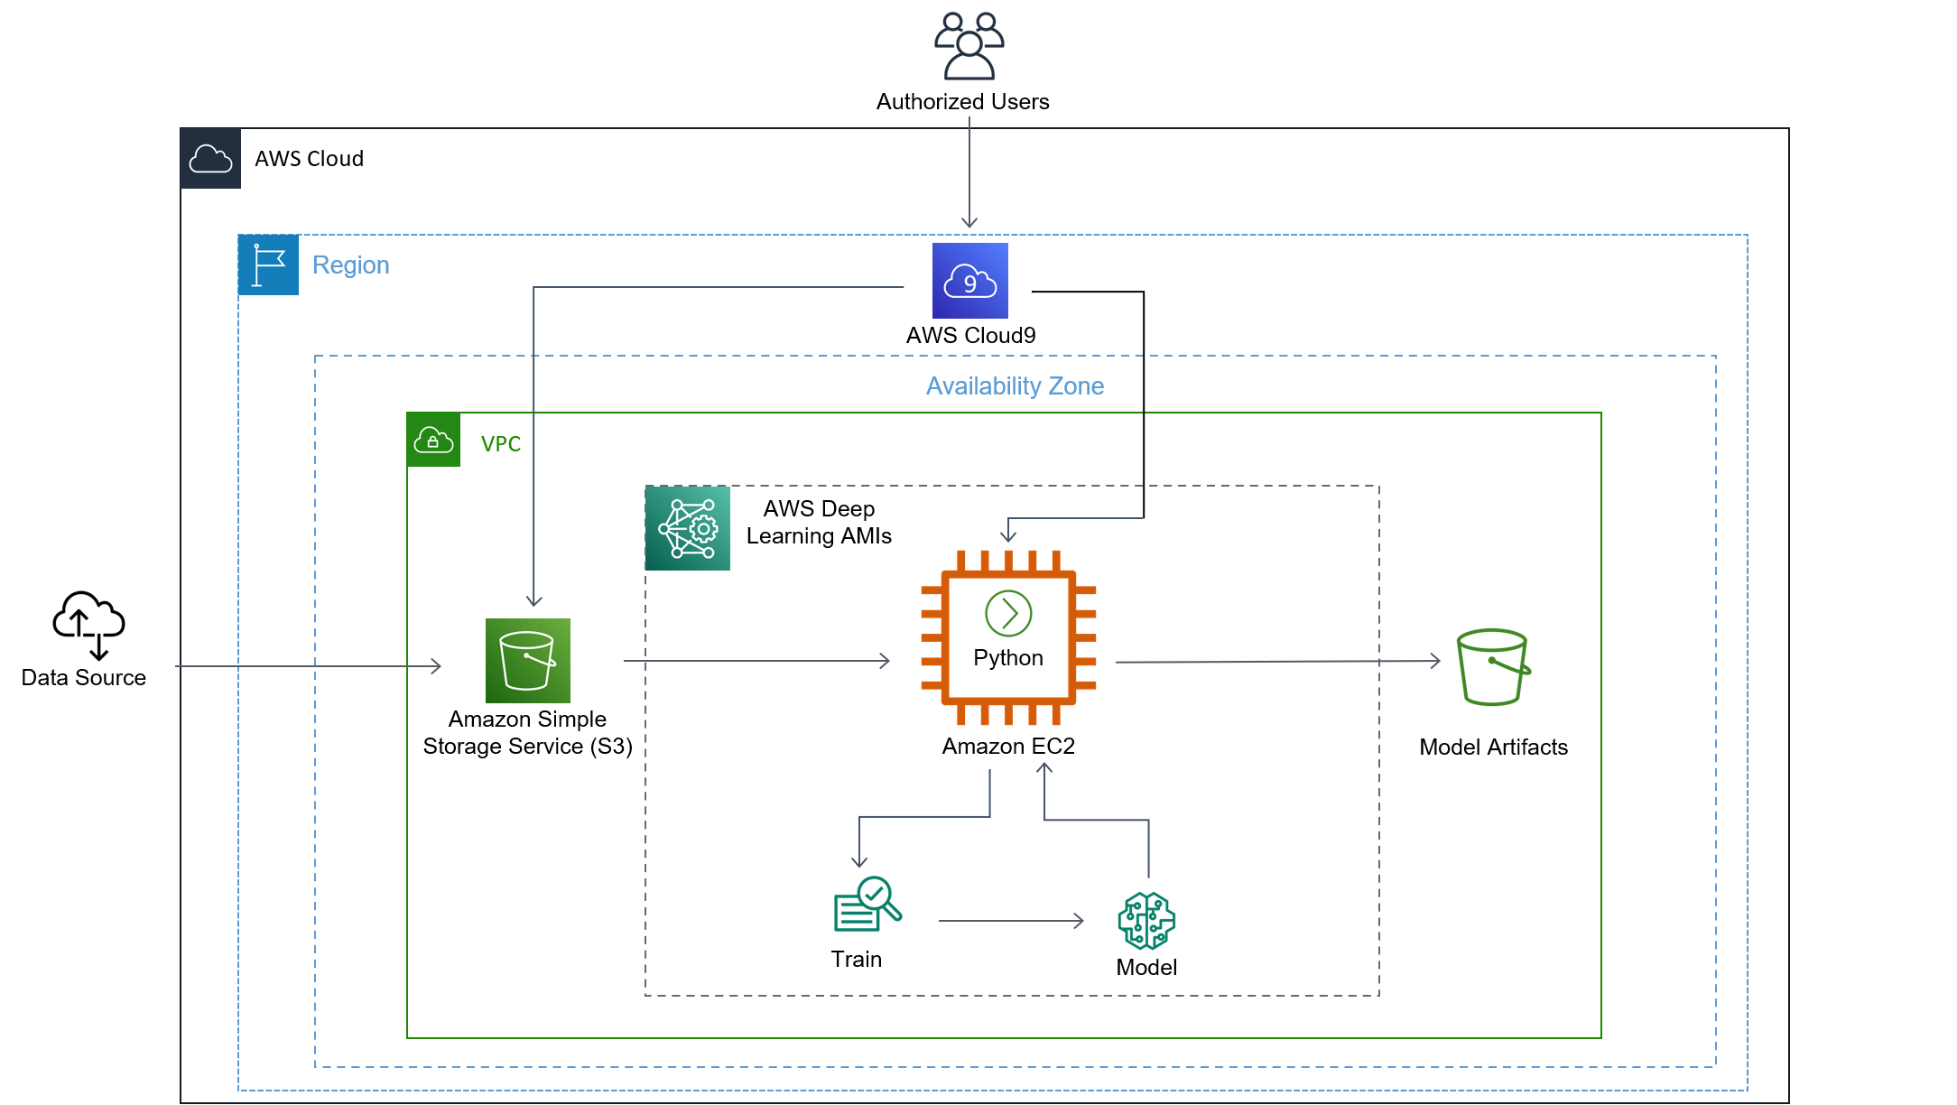
Architecture for Deep Learning EC2 Deployment

Slide 8
Cloud Architecture Demo

Slide 9
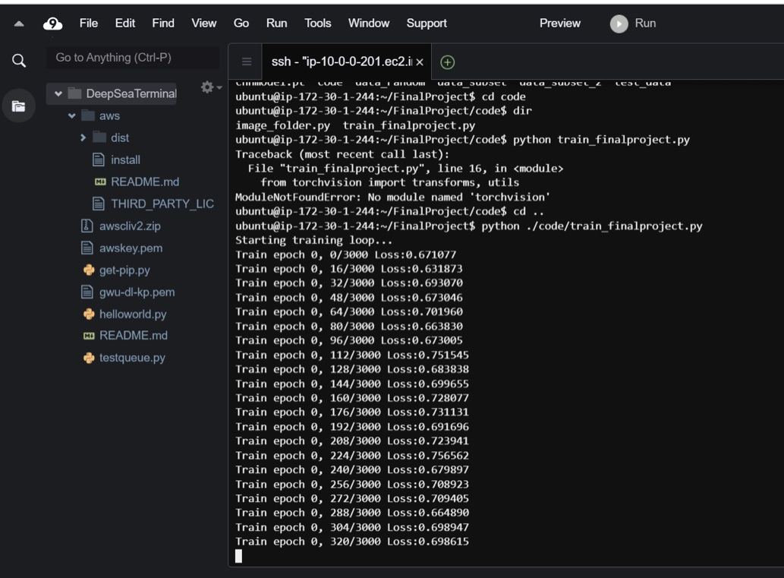
Python Running the Model on the
Deep Learning EC2

Slide 10
68%
Overall Accuracy Achieved

Slide 11
Findings & Cautionary Tales
Ran much faster than on a typical personal computer
Auto Scalability or using more GPUs would likely have improved the run time even more but would have added to the cost of running the model
Understanding of EC2 Ubuntu choices for deep learning is important (ie make sure the family you select has the capacity and features you need)
GPUs do not exist in all availability zones or on every option of deep learning Ubuntu (Don’t select a T when you really need a G or a P!)
The future the process would be simplified by figuring out feed the data directly from the S3 to the running python program on the EC2

Slide 12
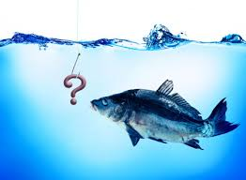
Questions?

